Slide 1
TOPIC B2:
PROGRAMMING
LESSON B1-3
FLOWCHARTS

Slide 2
AGENDA
Flowcharts
Flowchart Symbols
NOTE!
Have a way to take notes and a way to write code available for this lesson

Slide 3

THE WARM UP QUESTION
Write a plain text algorithm for how you get ready for school in the morning

Slide 4
THE WARM UP ANSWER
Snooze my alarm (x6)
Roll out of bed
Turn on the shower
Feed my snorlax in Pokemon Sleep (shower warms up)
Take shower
Get Dressed
Pack Lunch
Leave

Slide 5
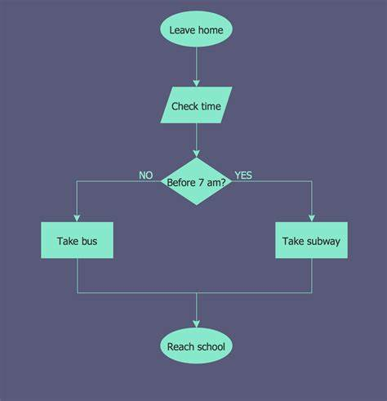
FLOWCHARTS
Flowcharts are used to design algorithms and to describe them using diagrams
They can be used to
Track variable changes,
Show execution flow
Determine the expected output of an algorithm

Slide 6
FLOWCHART SYMBOLS
Process
Input or
Output
Decision
Terminator

Slide 7
FLOWCHARTS
Input or
Output
Let’s look at the following problem:
Request the user input two numbers from the keyboard, then output their average
Let’s classify our events:
Input: two numbers
Output: average
Process: calculate the sum, then calculate the average
Terminator
Process
Decision

Slide 8
FLOWCHARTS
START
Input a,b
Sum = a + b
Avg = Sum/2
Output Avg
STOP

Slide 9
FLOWCHARTS
Input or
Output
We can also include the ability to make decisions in our algorithms
For example, if we would like to output the larger of the two different inputs, our diagram would look like this:
Terminator
Process
Decision

Slide 10
FLOWCHARTS
START
Input a,b
a > b
TRUE
FALSE
Output a
Output b
STOP

Slide 11
FLOWCHARTS
Input or
Output
What would a program that loops to print out each even number from 0 to 10 look like as a flowchart? Let’s try to make it
Terminator
Process
Decision

Slide 12
FLOWCHARTS
Input or
Output
Now, let’s try and do a selection sort flowchart
Terminator
Process
Decision

Slide 13
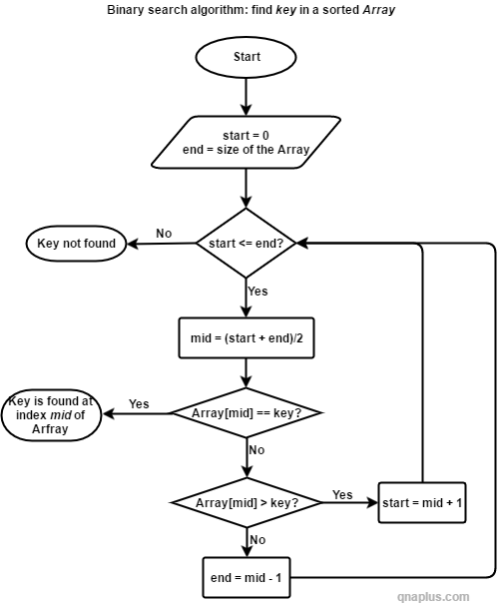
DEXTER’S LAB
Draw a flowchart to represent the solution for the following problem:
Initialize a number to zero. Ask the user to enter 50 integer numbers, adding the positive ones to a sum, and counting how many negative numbers are entered. Output both the sum and the total.
Draw a flowchart for the bubble sort algorithm
Identify what the algorithm to the right is doing

Slide 14
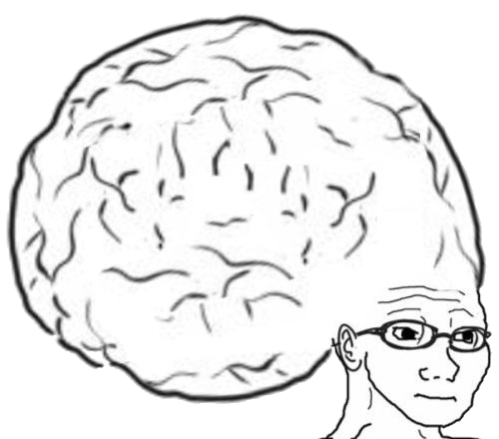
VOCAB TO REMEMBER
Flowcharts

